Slide 1
Digital Image Processing
Associate Prof. Zhang Qingfeng(张庆丰) Department of Computer Science, Jinan University
Office Room: 415, Nanhailou Building
Email: zqf135@qq.com
1

Slide 2
Chapter 4
Filtering in the frequency Domain (I)
2

Slide 3
Contents
1. Problem and Discussion
2. Test
3

Slide 4
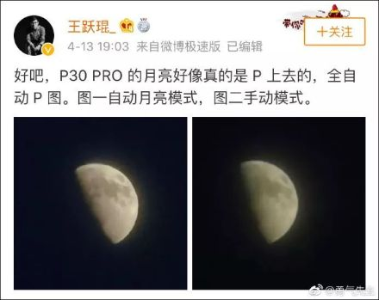
1. Problem and discussion
The Moon’s photo taken by Huawei P30 Pro

Slide 5
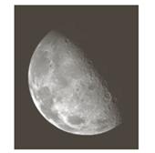

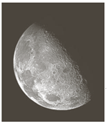
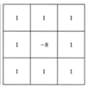
Example of enhancement

Slide 6
2. Test
(1) Write down the expression of 2D discrete Fourier Transformation
(2) descript the physical meaning of Fourier Transformation
(3) list any three properties of Fourier transformation

Slide 7
The 2D discrete Fourier transform
Let f(x,y) for x=0,1,2, ..., M-1 and y=1,2, ..., N-1 denote an M×N image.

Slide 8
Inverse Fourier transform (discrete case)
u, v : the transform or frequency variables
x, y : the spatial or image variables

Slide 9
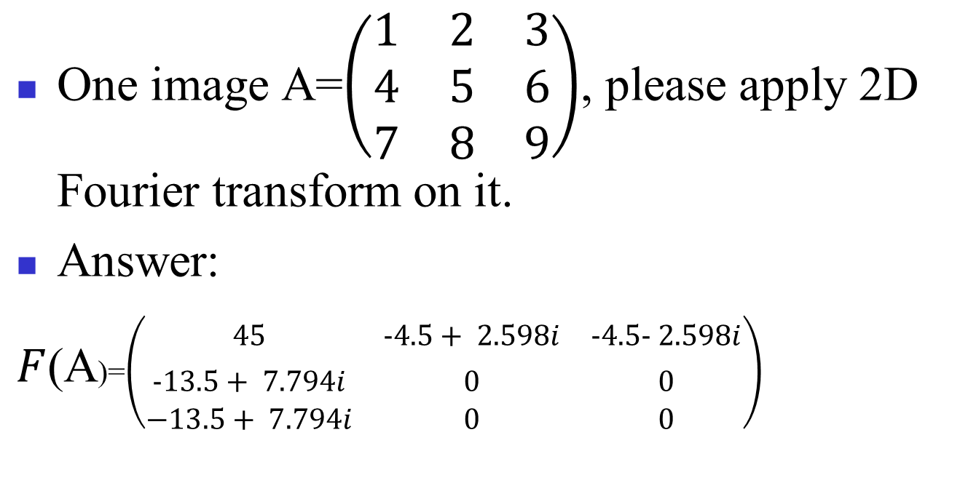
problem
One image A=$\left(\begin{matrix}1 & 2 & 3 \\ 4 & 5 & 6 \\ 7 & 8 & 9\end{matrix}\right)$, please apply 2D Fourier transform on it.
Answer:
$F$(A)=$\left(\begin{matrix}45 & −4.5+ 2.598i & −4.5− 2.598i \\ −13.5+ 7.794i & 0 & 0 \\ −13.5+ 7.794i & 0 & 0\end{matrix}\right)$

